Slide 1

a gentle introduction

Slide 2
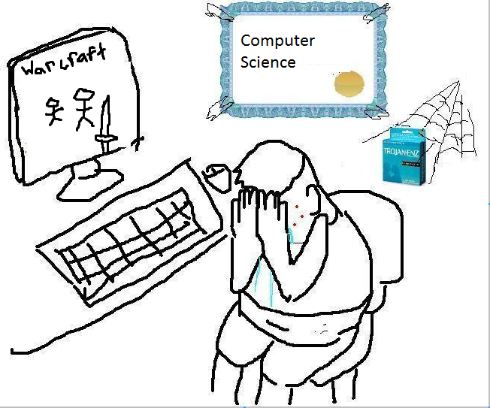
(compsci time2shine)

Slide 3
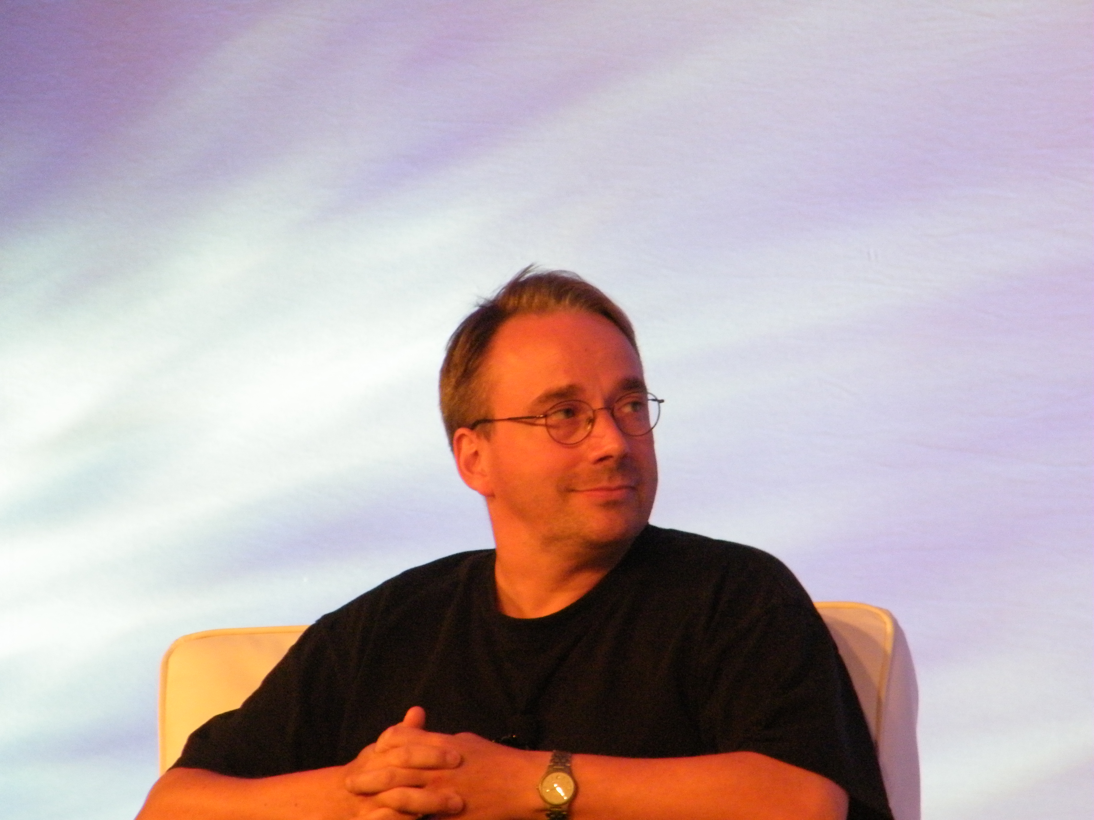
“I'm an egotistical bastard, and I name all my projects after myself.
First Linux, now git.”

Slide 4
Understanding the love
You do not know the pain of SVN
‘Good enough’ does not scale
Big projects painful in older VCS
Distributed system
Branches in local copies
Can have multiply linked repos
Doesn’t have to have a central repo

Slide 5
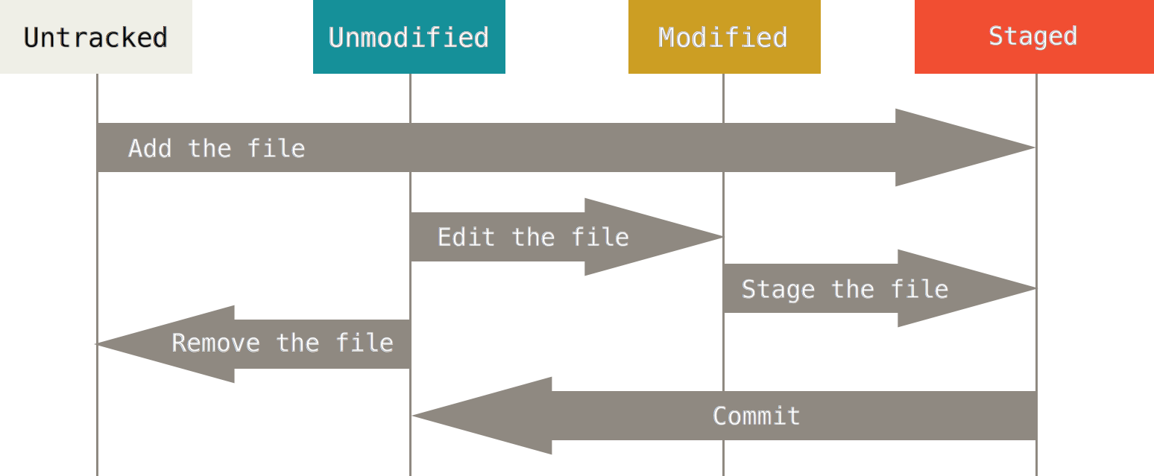
Repositories
Image shamelessly stolen from here

Slide 6
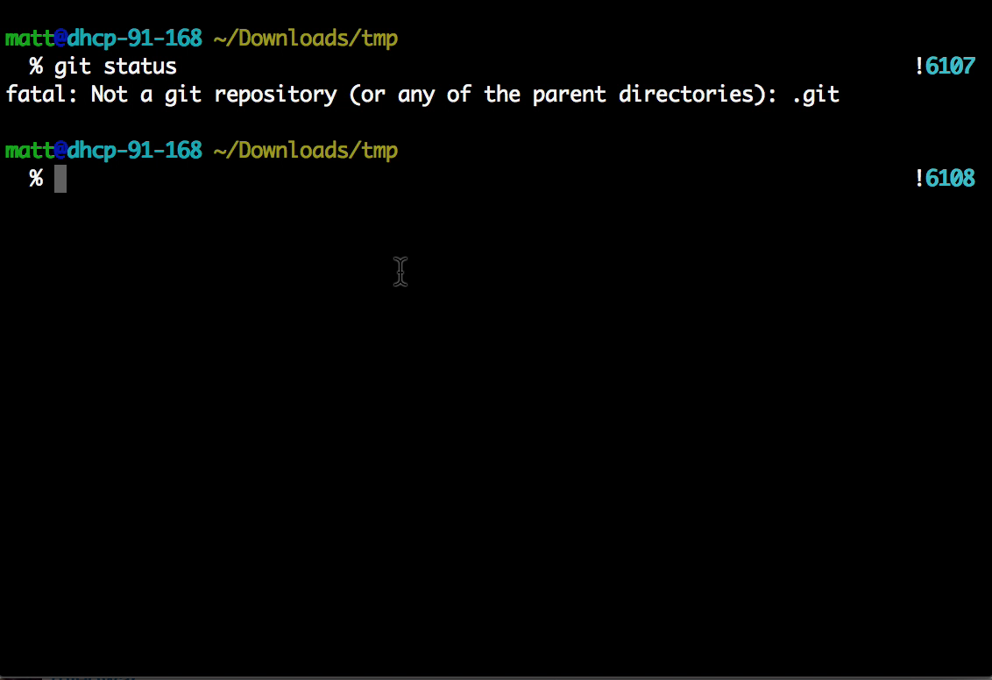
Initialising: git init

Slide 7
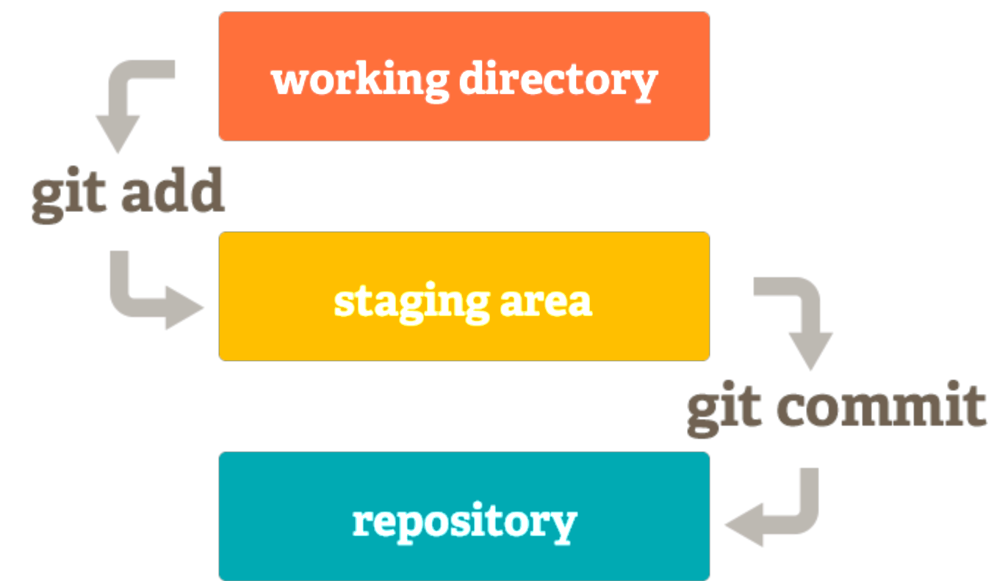
Commit Process

Slide 8
Commit Early, Commit Often
1 commit = ‘unit’ of change
Multiple commits over 1 feature:
Finer control over what steps taken
If something breaks, easier to narrow down
Much better for collaboration

Slide 9
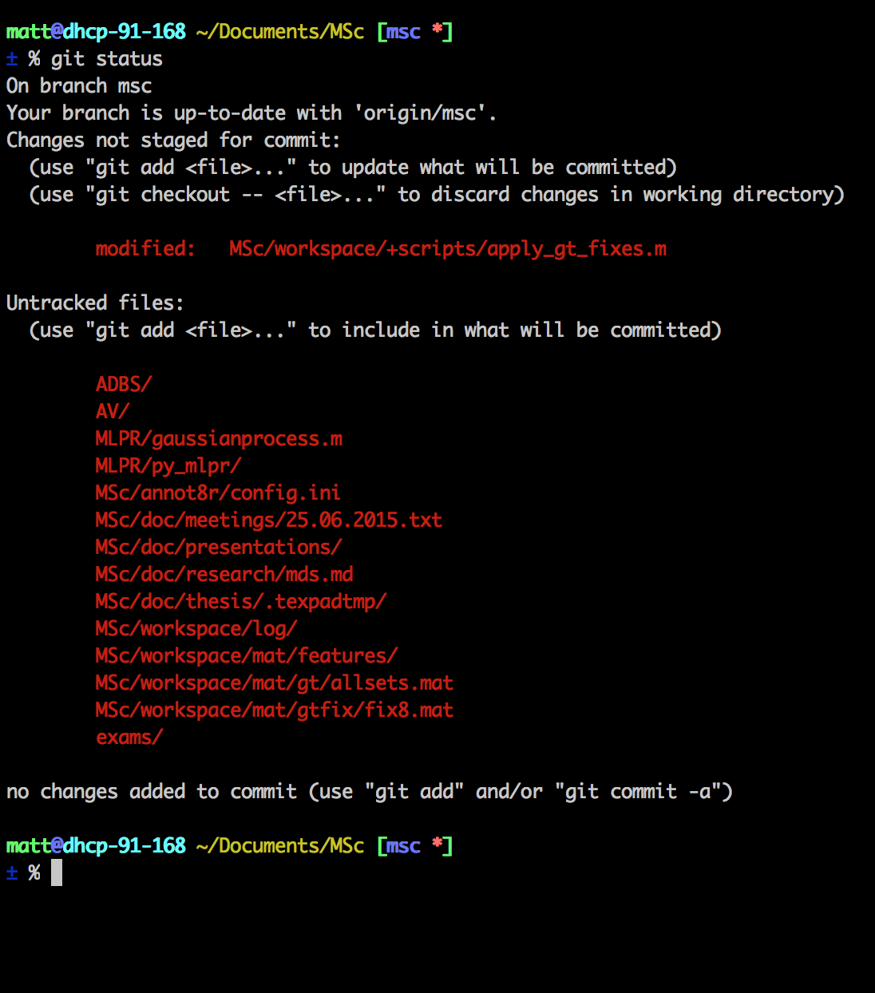
git status
Which branch you’re on
What’s new
What’s changed
What’s gone
Up to date with remote?

Slide 10
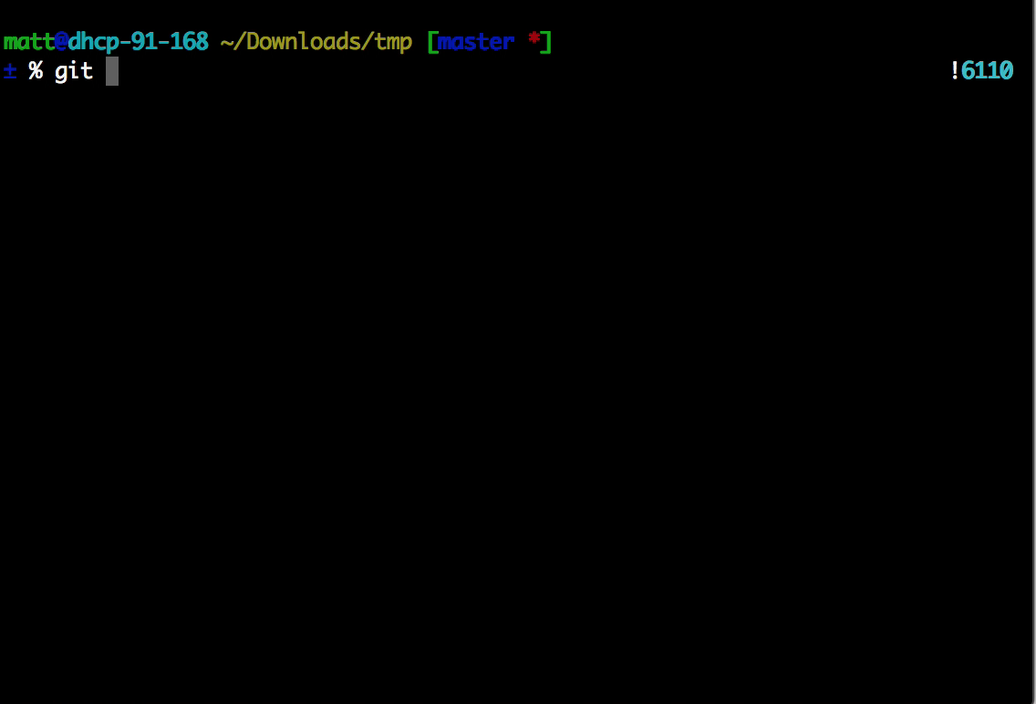
Staging / Adding: git add <file>

Slide 11
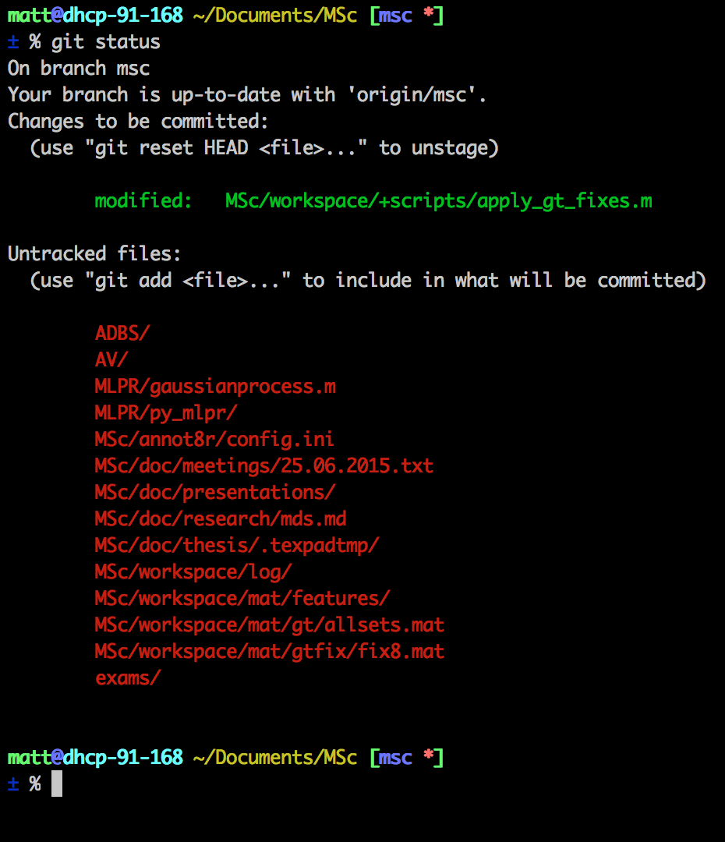
Staging
Purgatory
Can still reset with git reset HEAD <f>
Committing now puts it into the history
Only files in green are committed

Slide 12
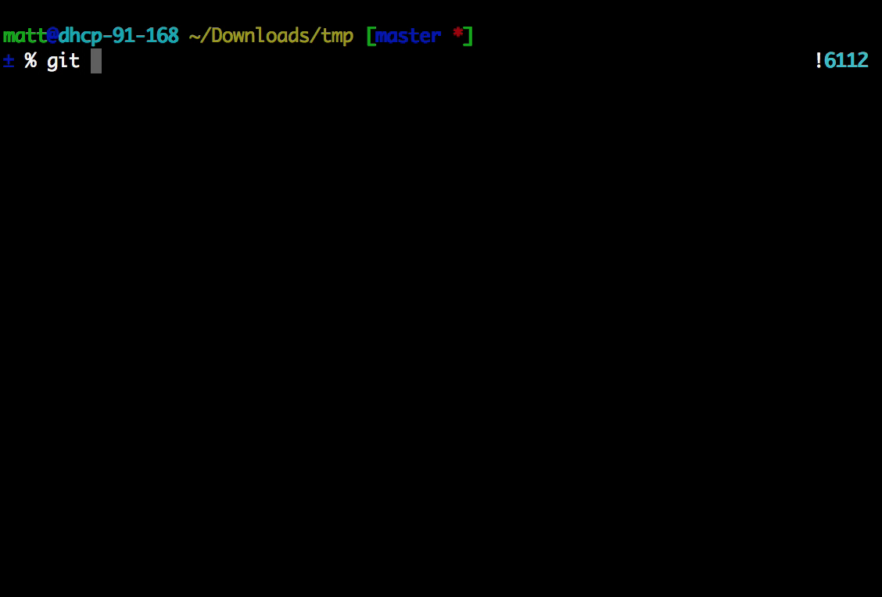
Committing: git commit

Slide 13
Commit Messages
Make them meaningful
‘Changed algorithm.py’
Doesn’t really help, git shows you it changed
E.g. if the change was deleting a class
probably important
probably not well thought out
don’t want to be guessing where this happened
Messages are a narrative for yourself

Slide 14
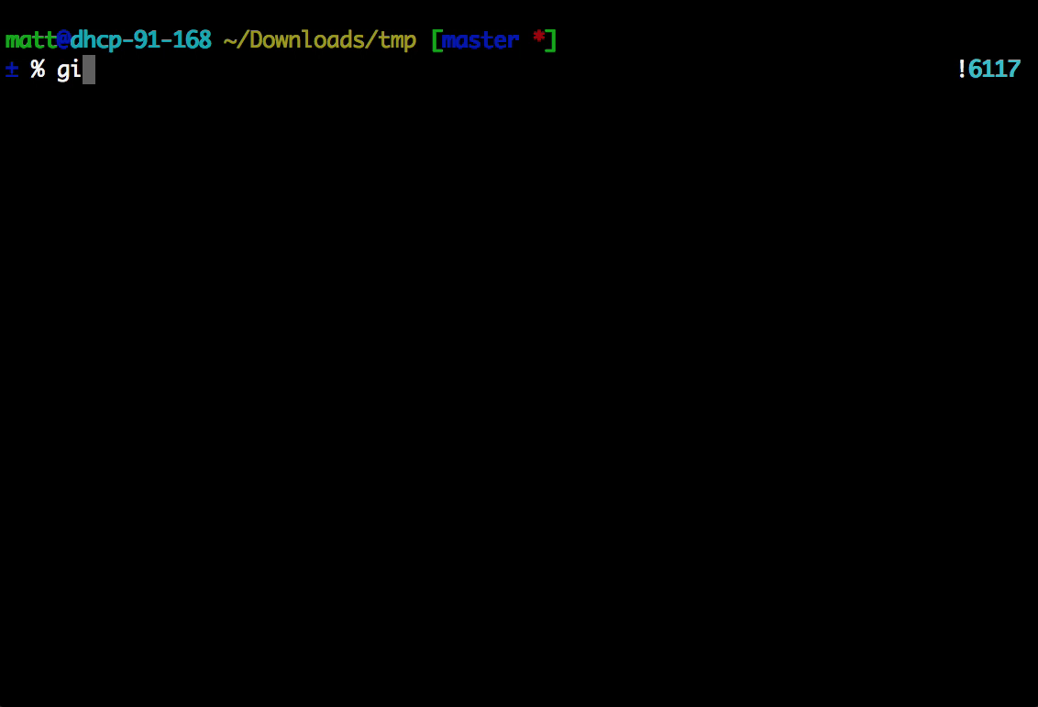
Exclude & Ignore

Slide 15
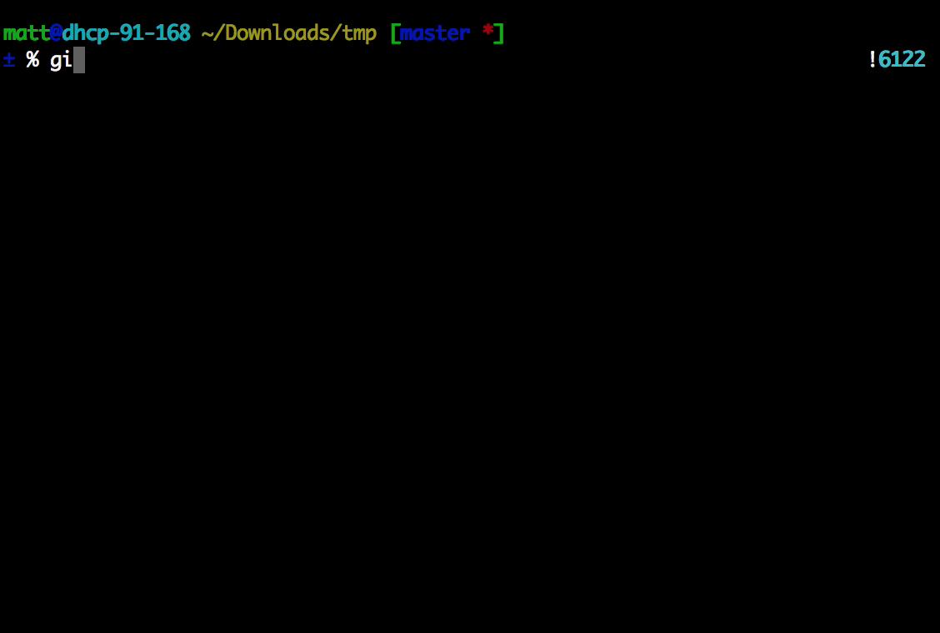
Diff (working copy) git diff <opt:file|branch>

Slide 16
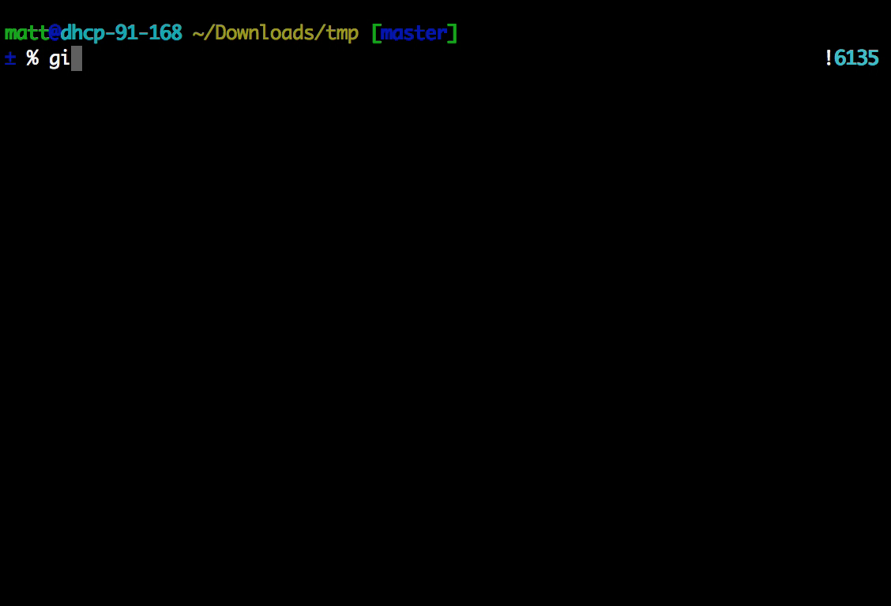
git log

Slide 17
git log git reflog
HEAD is the tip of the tree
Shows the entire ancestry of HEAD
Applies to all instances of the repo
Local only
Pruned 90 days
History of commits in your working copy

Slide 18
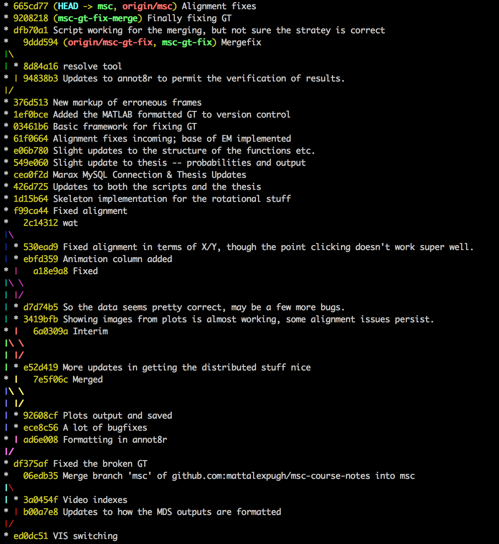
git log --graph --decorate --oneline
Visualise branches
Full commit details
Simple to find previous state to go back to

Slide 19
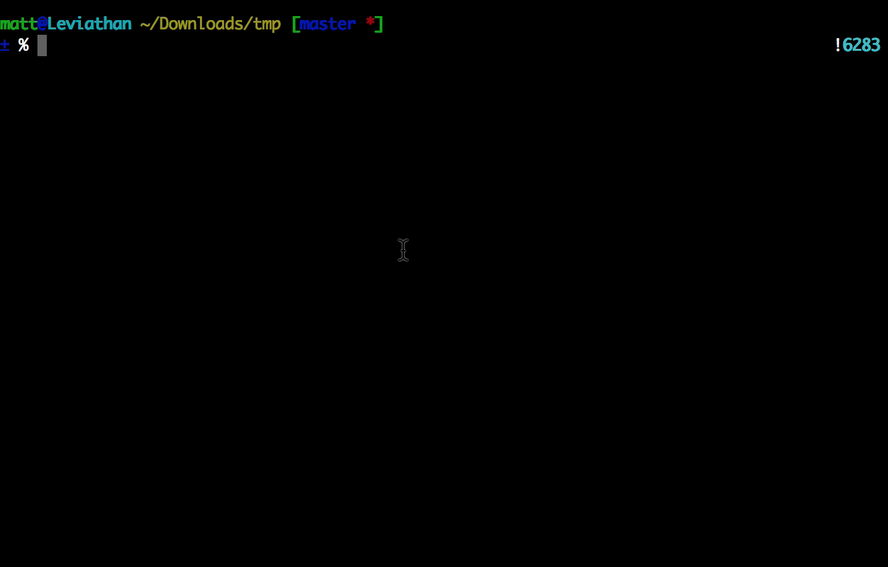
I want to store this work, but not commit it: git stash

Slide 20
I have made a mistake (locally). git reset
git reset <file>
git reset <opt:commit>
git reset --hard <opt:commit>

Slide 21
I published a booboo: git revert <commit>
Makes a new commit
undoing the previous one

Slide 22
HEAD
Points to the tip of the tree
Can do pointer arithmetic on it:
git reset HEAD-2
Go back two commits
git revert HEAD

Slide 23
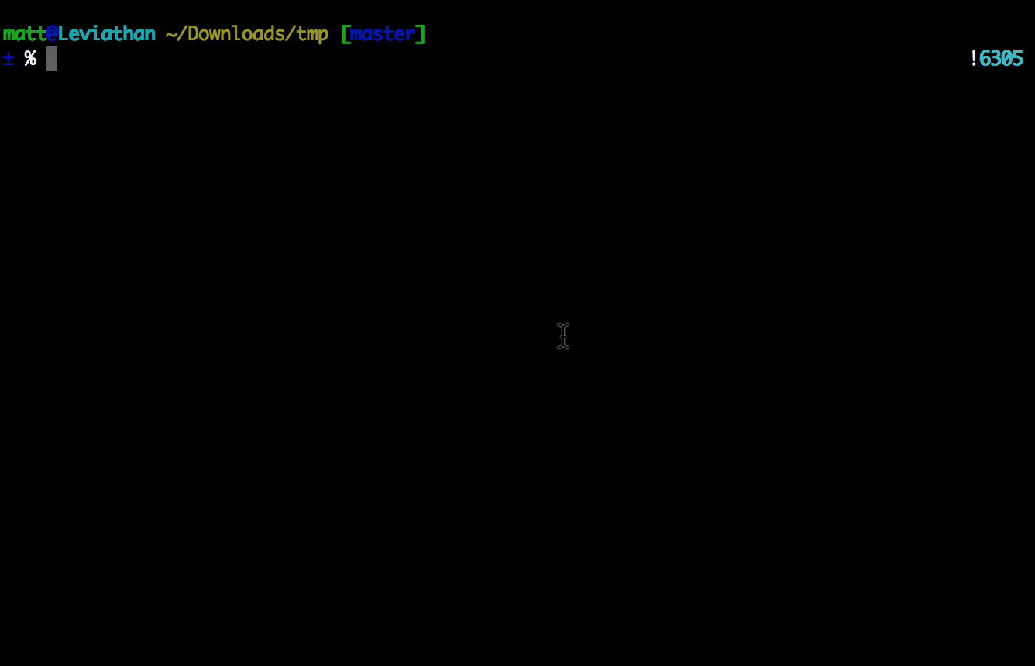
I have a fun experiment idea: git branch

Slide 24
Storing Experiment Configuration
Previous CDT Tea: Store as files of params
Just make a commit at the point of experiment
Need to re-run? Check out that commit as a different repo.
Everything (including any code changes) now the same.

Slide 25
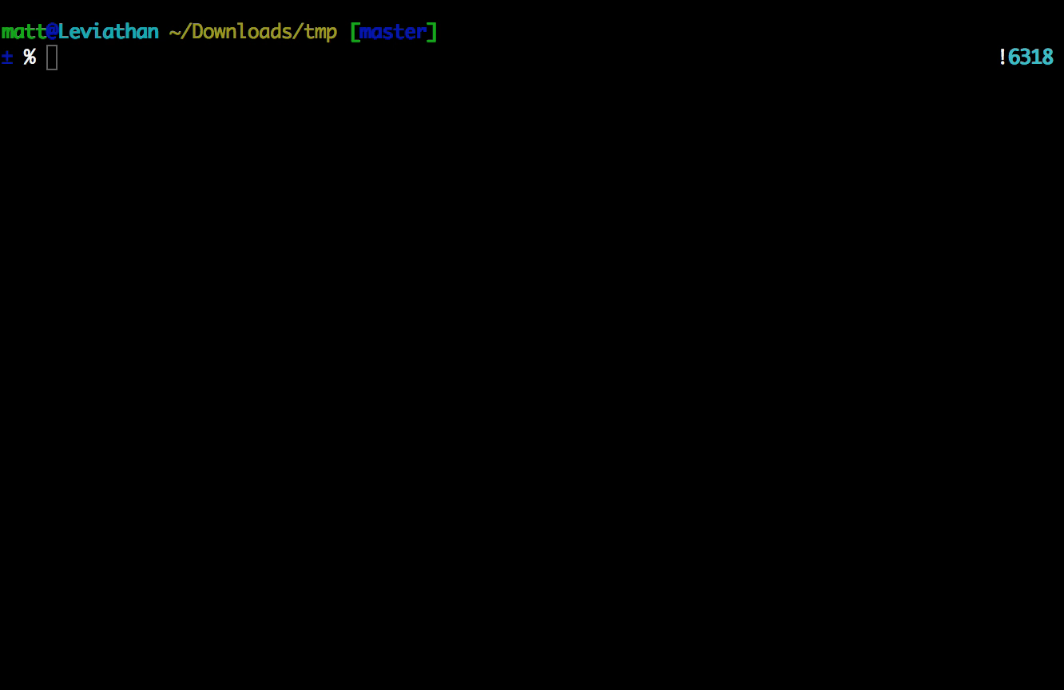
The experiment worked! git merge <branch>

Slide 26
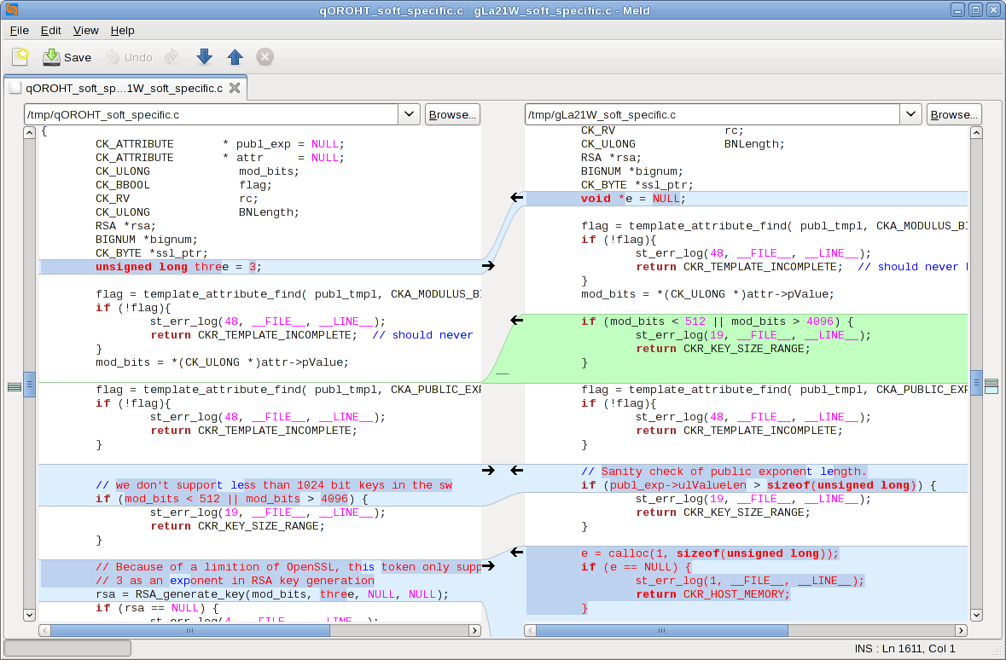
Mergetools: F_{LOC} vs. F_{REM} = 🙈

Slide 27
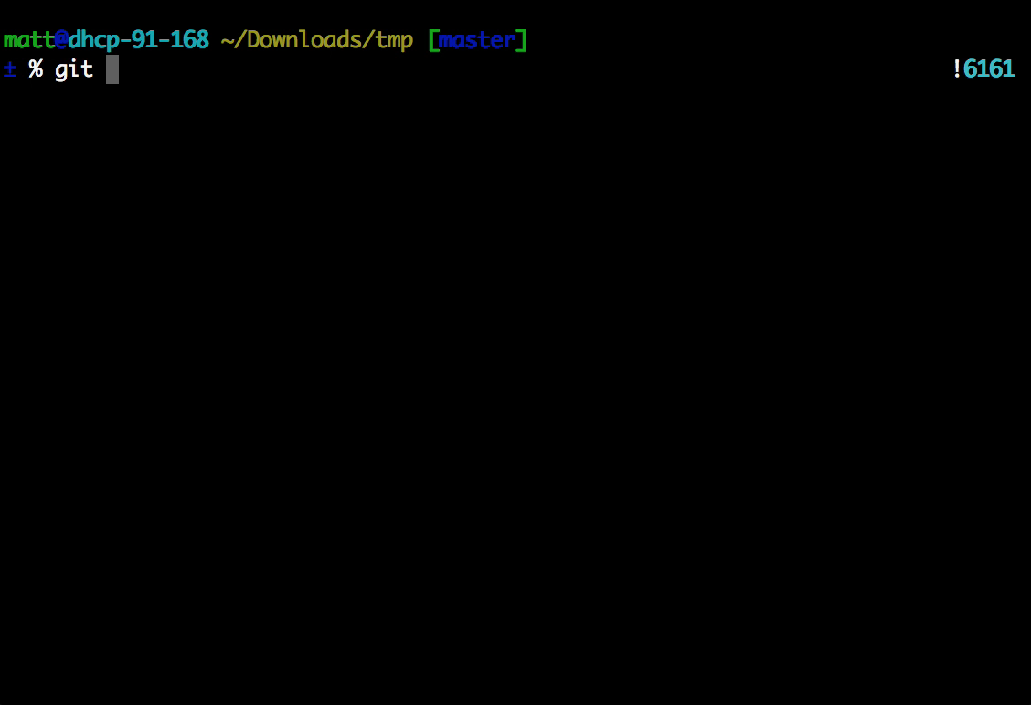
Checkout a Specific Commit

Slide 28
Forking & Cloning
Cloning:
Usually read-only
Forking:
You put a fork in the road
Codebases diverge at point of fork
Still able to pull updates from original if you link repositories (git remote add)
Can submit your code (patch) to go back to the original repo (pull request)

Slide 29
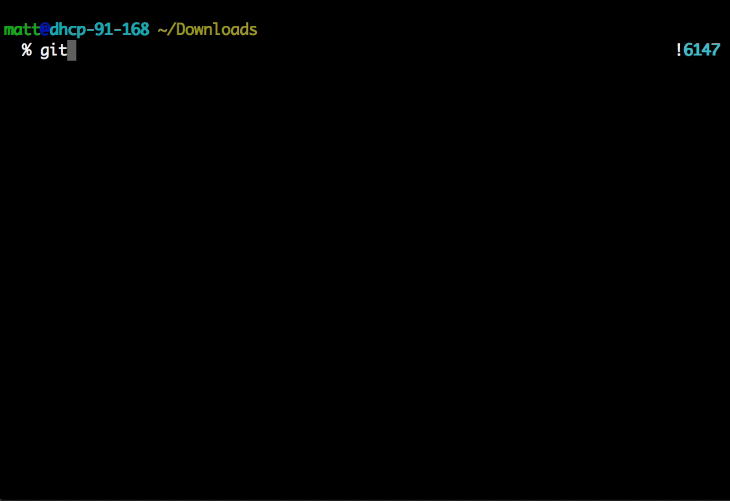
Cloning & Resetting

Slide 30
Pushing & Pulling
git push <repo> <branch>
Satisfied with local changes
Want to share all new commits to others
git pull <repo> <branch>
Want to get all the new updates from others
Can pull from any repo or branch
Bad things can and do happen
Conflict resolution via diff etc.

Slide 31
Collaboration
Dev A
git push origin master
GitHub
Repo
git pull origin master
Dev B
Dev C

Slide 32
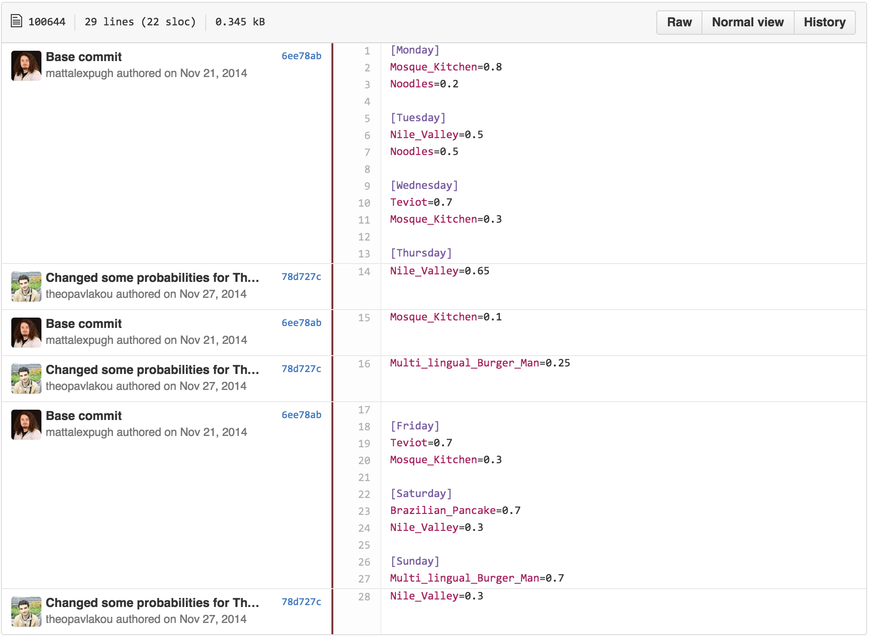
git blame <file>

Slide 33
If you haven’t signed up for it, you probably should.
CDT GitHub

Slide 34
SSH / HTTP Authentication
HTTP = username & password for :
Public:
every push
Private:
every pull
every push
SSH = authorised by public key(use this)
Stored in GitHub profile

Slide 35
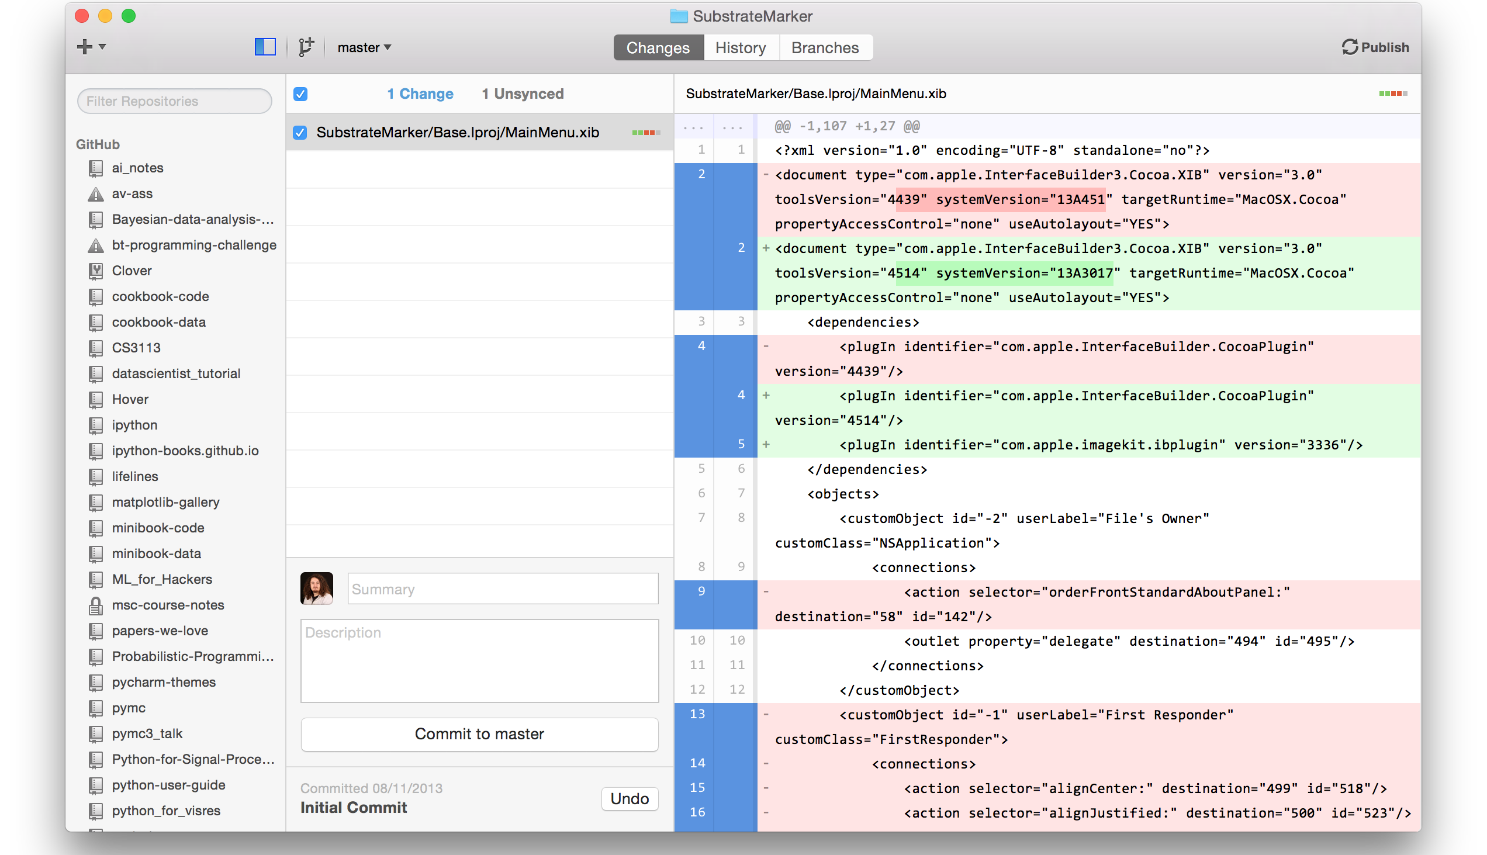
GitHub Application (Mac/Win)

Slide 36
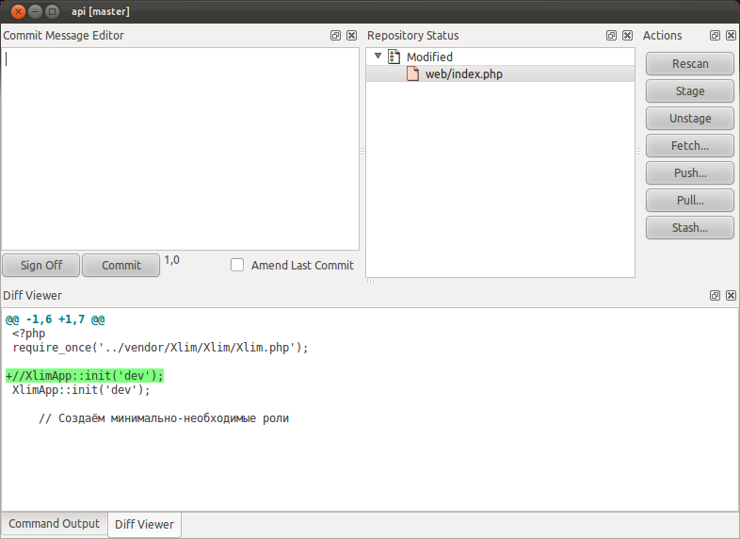
Linux – git Cola*
*really not many good GUIs

Slide 37
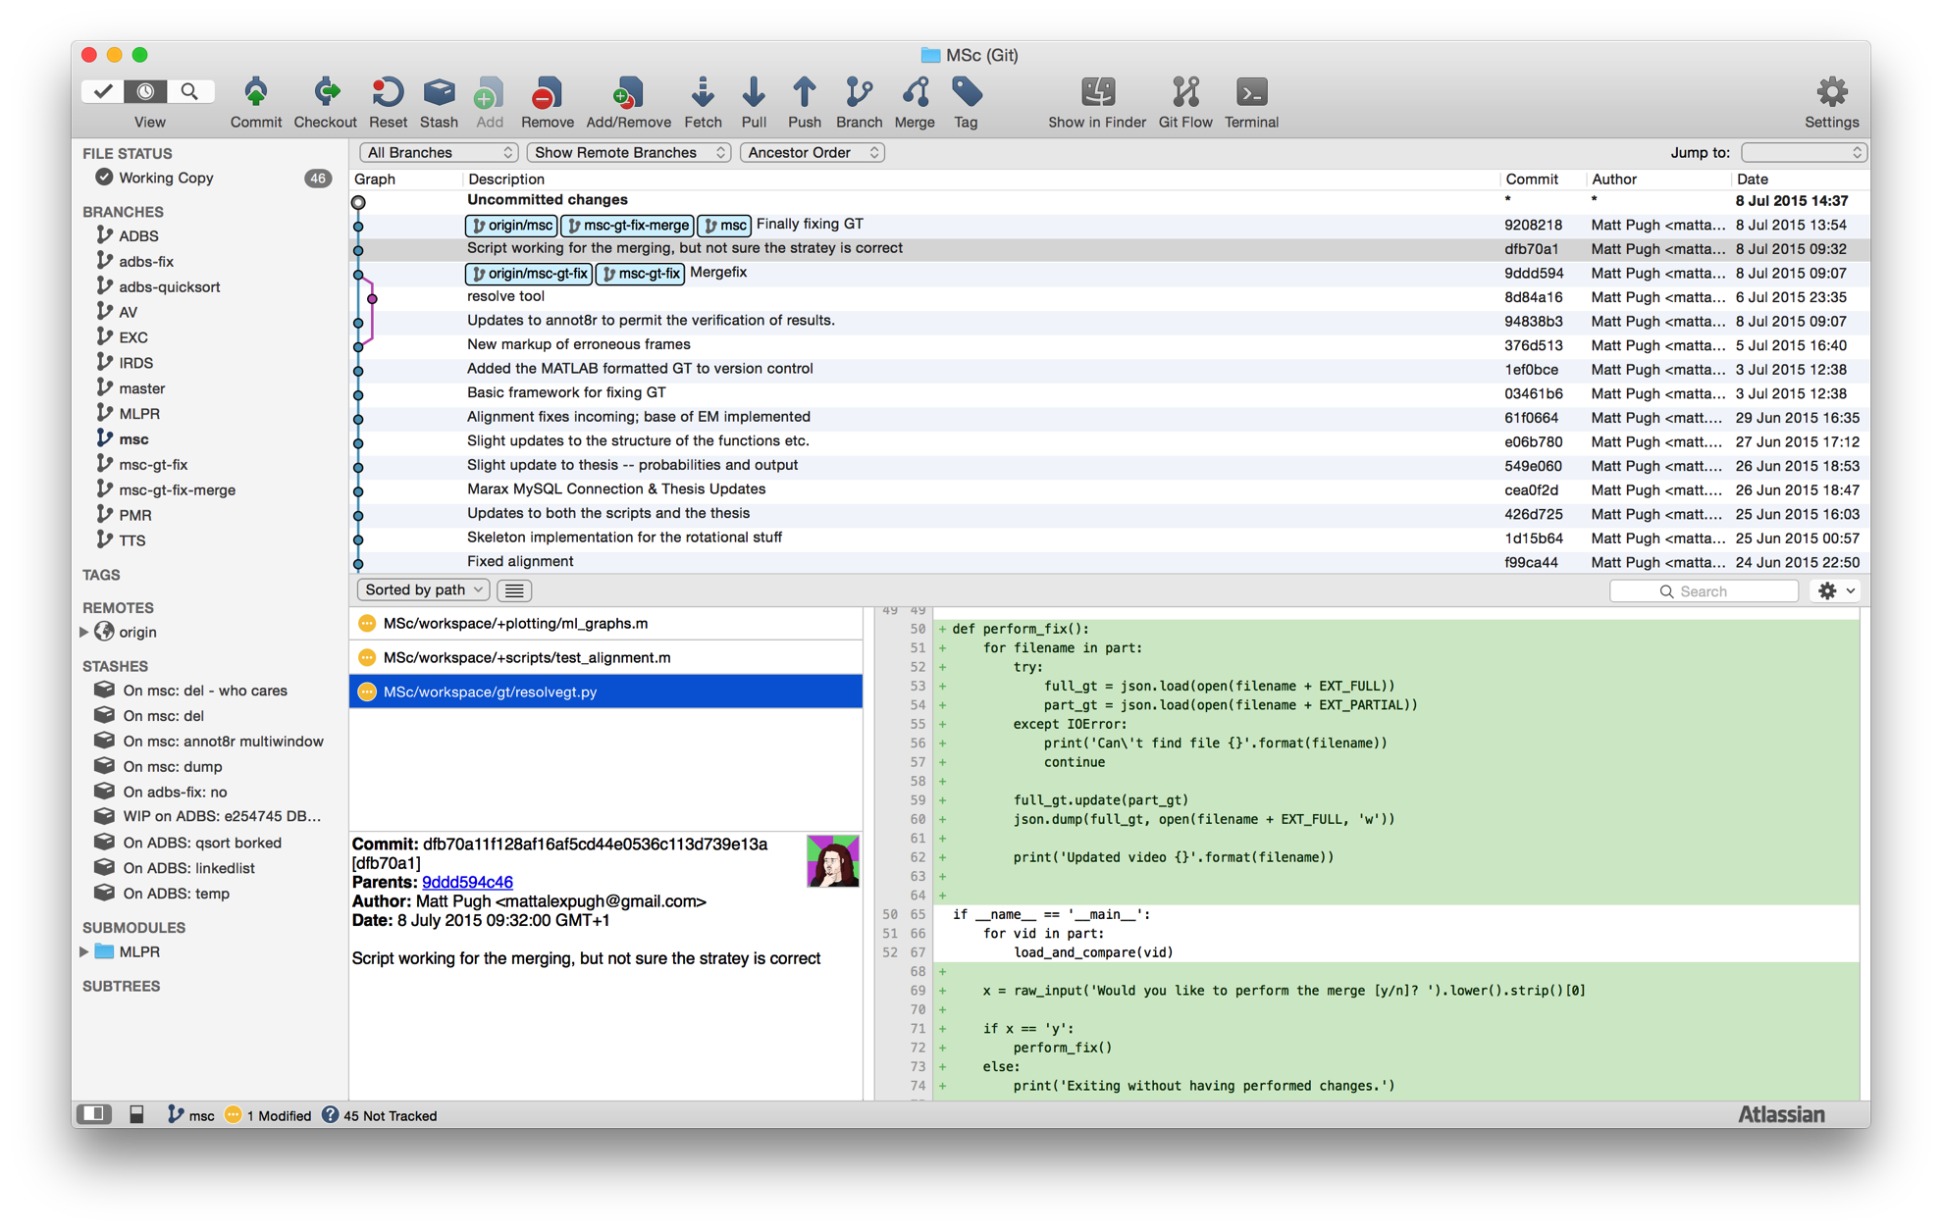
Mac - SourceTree

Slide 38
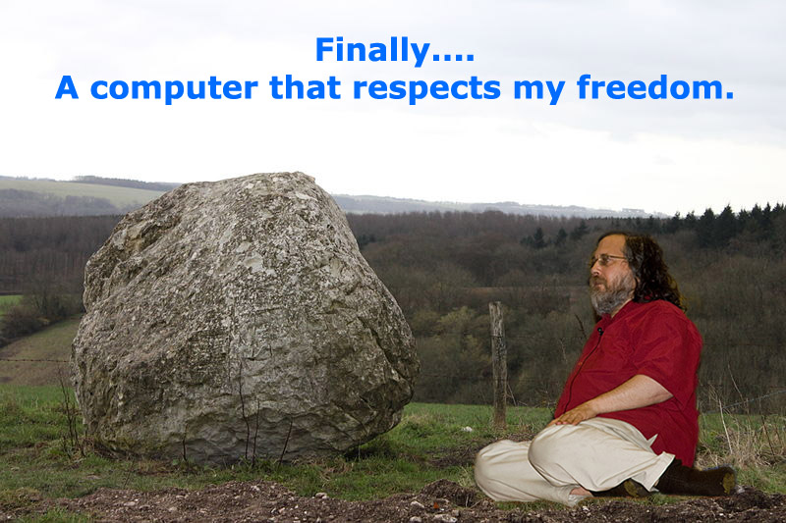
Windows – switch to Linux.

Slide 39
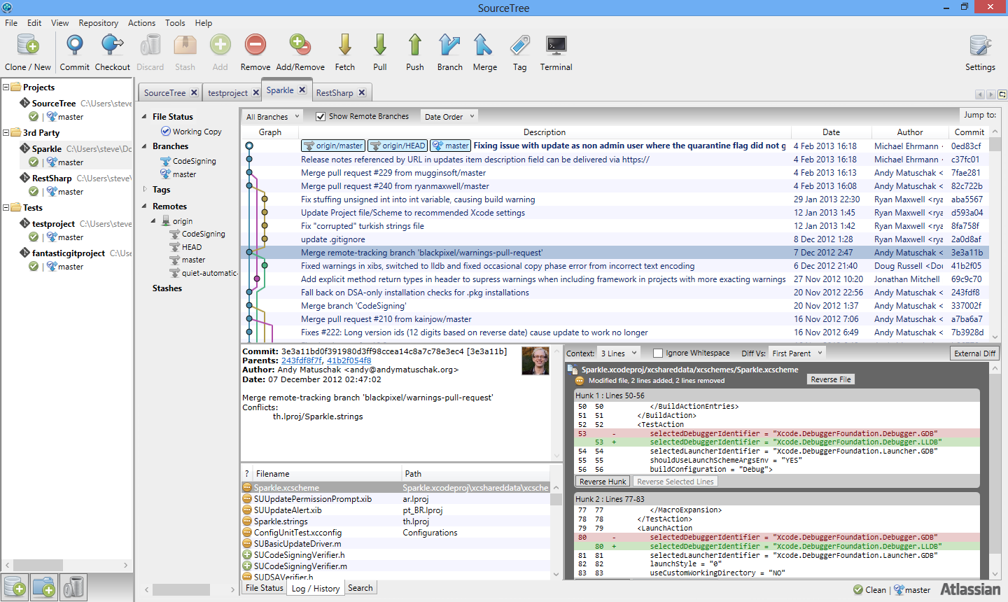
Windows - SourceTree

Slide 40
Can git anything on the computer
Programs & files
What changes when the trial runs out?
Photos
Before editing etc.
OS…?
Okay this one’s made up.
But it could work.
…
I’m going to try it.

Slide 41
Resources
http://www.git-tower.com/blog/git-cheat-sheet/
https://git-scm.com/book/en/v2/Getting-Started-Git-Basics
https://www.atlassian.com/git/tutorials/
https://www.sourcetreeapp.com/

Slide 42
Thank You
If you have questions,
please feel free to ask on StackOverflow

Slide 43

Goodbye.

